Slide 1
FINAL PRESENTATION
PEEKABOO
권희재 김종헌

Slide 2
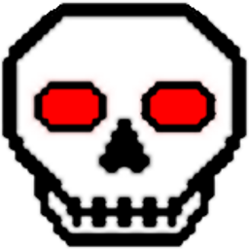


HIGH CONCEPT
Revenant is 2D side view cooperate shooting platform game.
There are monsters called Revenants, the living dead. They bully people so much. Our characters’ mission is catch them for people’s safe.
Mike Nike
BornBone

Slide 3
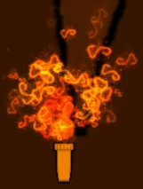
Player Health
5 Torch is player’s health.
When you hit by the boss, 1 torch will go out.
If all the torch is go out, you will lose.

Slide 4
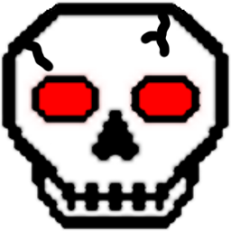
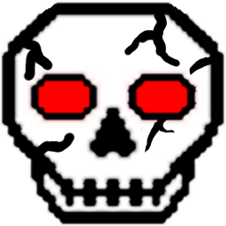
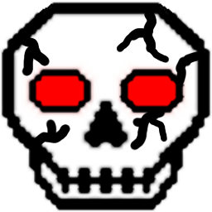
Boss Health
We describe health of boss as the crack of bornhead.

